Slide 1
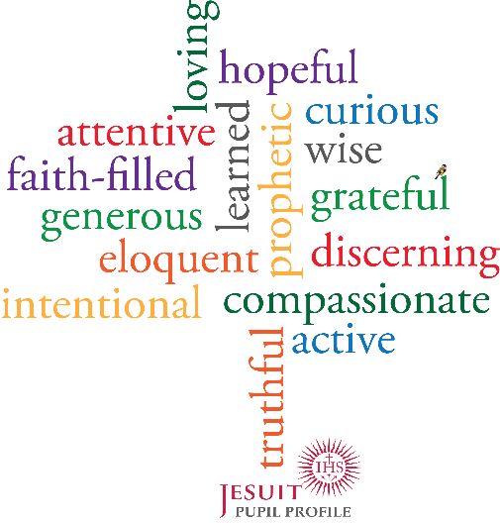
loving
hopeful
&
curious
attentive
learned
wise
faith-filled
prophetic
grateful
generous
eloquent
discerning
intentional
compassionate
active
truthful
Notes:
3 Compassionate & Loving

