Slide 1
The Examen

Slide 2
Contents
Calming/Stilling Exercise (optional)
The Examen - an introduction
The Examen Prayer instructions then click to go into automated Examen with music

Slide 3
Calming/Stilling Exercise (optional, please skip if you don’t think you will have time)
Find a comfortable sitting position, and whilst watching this calming video for a few minutes and listening to the music, simply focus on your breathing, becoming aware of every breath in, and out.
(click link below to start video).
https://www.youtube.com/watch?v=0T-KR_2DU_0

Slide 4
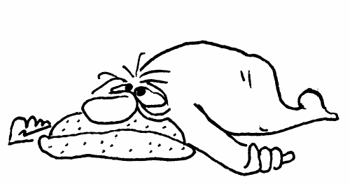
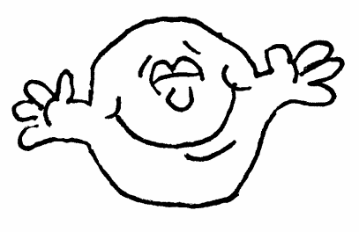
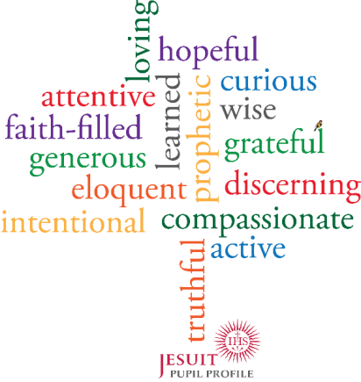
The Examen
is a daily exercise from the Spiritual Exercises of St Ignatius Loyola
It begins with gratitude,
and, in God’s light,
is curious and attentive to the patterns of our thoughts, feelings & desires.
Noticing what leads to consolation & desolation.
So that, being guided by faith, hope and love,
I can discern better and intentional choices to make,
resulting in more generous action.
That’s the “magis”

Slide 5
Instructions
Once you click to advance this slide the rest of the examen is timed and will run through to the end.
The prayer lasts 11 minutes.
There are 6 slides, each with points to reflect on.
The slides each have a timer circle to show how long there is left on that slide.
There is a chime when each new slide appears, so you do not have to look at the screen the whole time. You may find it useful to shut your eyes or put your head on the desk.
Before advancing to the next slide make sure you are all seated comfortably, with a clear desk in front of you, and are silent and ready to begin.
Start – “In the name of the Father, and of the Son, and of the Holy Spirit. Amen.”
Then click to begin.

Slide 6
Take a moment to still yourself & become aware that you are in the holy presence of God
1 min

Slide 7
Gratitude
Gratitude
2 min
Call to mind two or three things from this half-term that you are thankful for.
Maybe notice some things you have taken for granted.

Slide 8
What Stands Out?
Ask for Light
1 min
Ask God to be by your side as you come to review your day. Ask for his wisdom and guidance to help you notice where he has been present.

Slide 9
What Stands Out?
Re-view
3 min
Replay in your mind some of the moments where you have been you at your best, and some of the moments where you have let yourself down. Moments that have uplifted you, moments that have drained you.

Slide 10
Talk with Jesus – asking forgiveness
2 min
Replay in your mind some of the moments where you have been you at your best, and some of the moments where you have let yourself down.
Talk with Jesus about those things you have noticed that you are sorry for. Listen to the stirrings in your heart indicating Jesus’ response to you.

Slide 11
Talk with Jesus - Look to the future
2 min
Talk with Jesus about those things you would like to make a commitment to change for tomorrow.

Slide 12
The End
Remember God is Love and God Loves You!

Slide 13
Picture Credits: Water colour stain Designed by kjpargeter / Freepik

