Slide 1
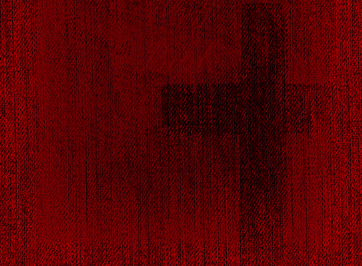
T E N E B R A E

Slide 2
My song is love unknown,
my Saviour’s love to me.
Love to the loveless shown
that they might lovely be.
O, who am I,
that for my sake
my Lord should take frail flesh,
and die?

Slide 3
He came from his blest throne,
salvation to bestow;
but men made strange; and none
the longed-for Christ would know.
But O, my friend,
my friend indeed,
who at my need his life did spend!

Slide 4
Here might I stay and sing,
no story so divine;
never was love, dear King,
never was grief like thine.
This is my friend,
in whose sweet praise
I all my days could gladly spend.

Slide 5
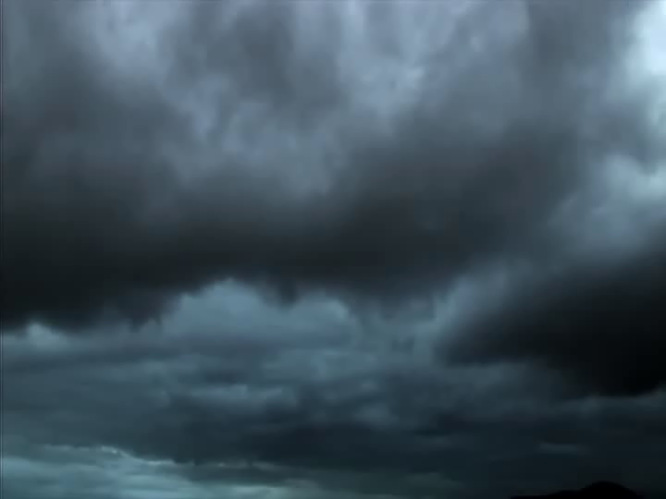

Slide 6
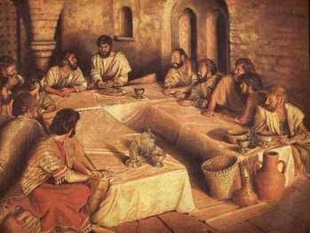
I

Slide 7
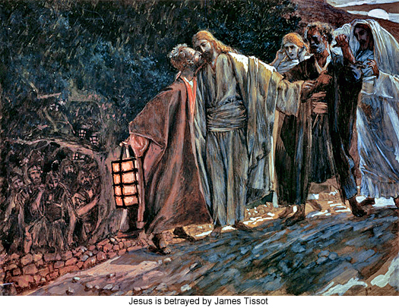
II

Slide 8
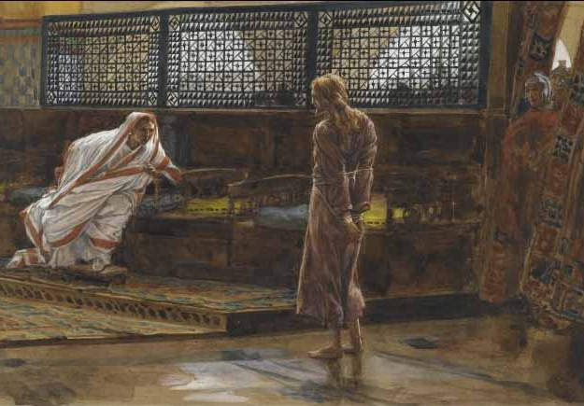
III

Slide 9
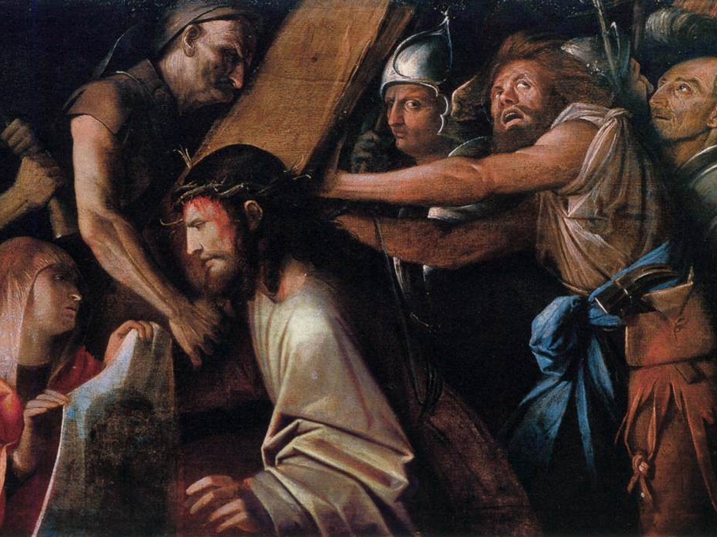
IV

Slide 10
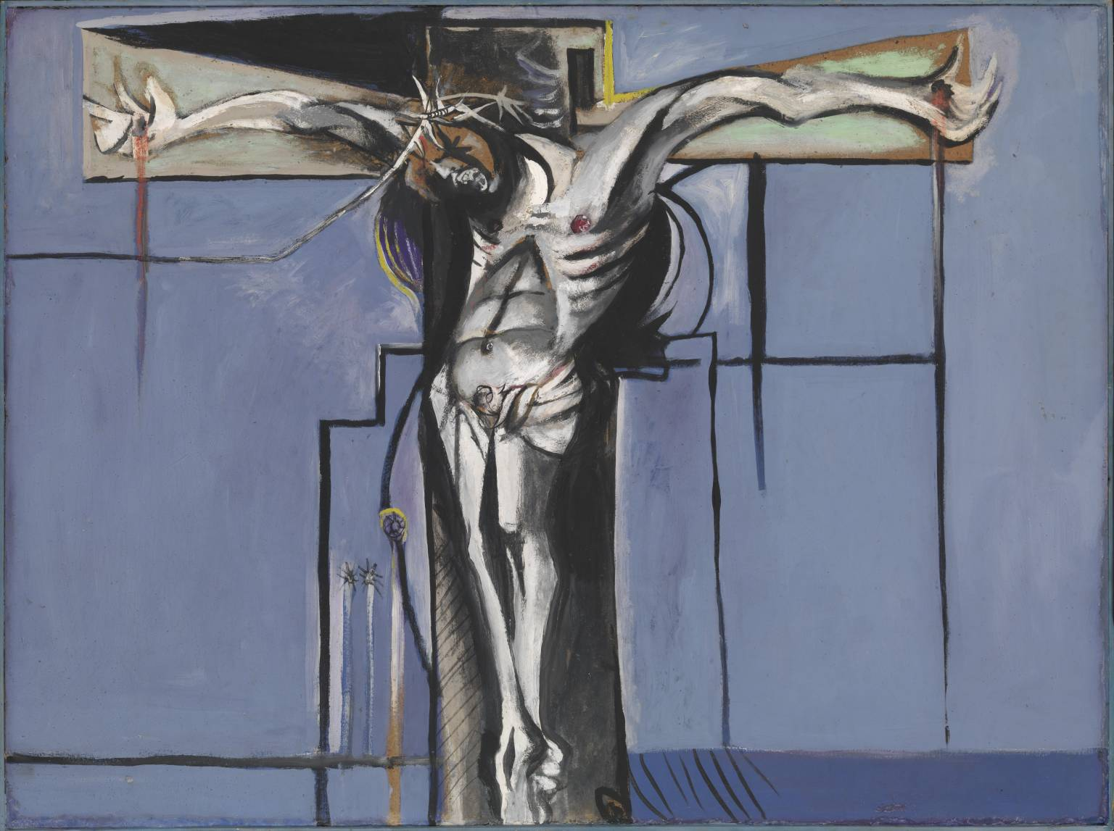
V

Slide 11
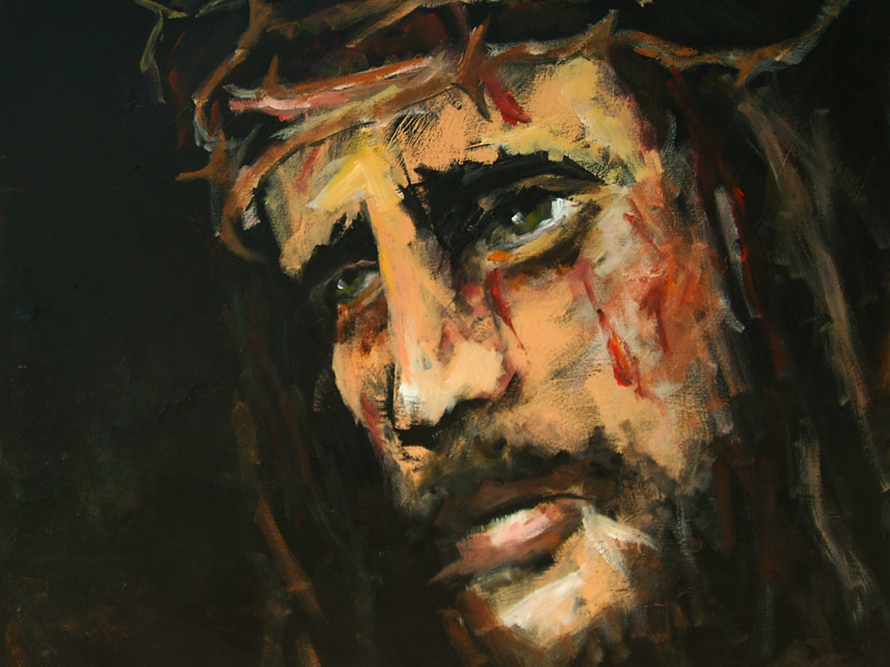
VI

Slide 12
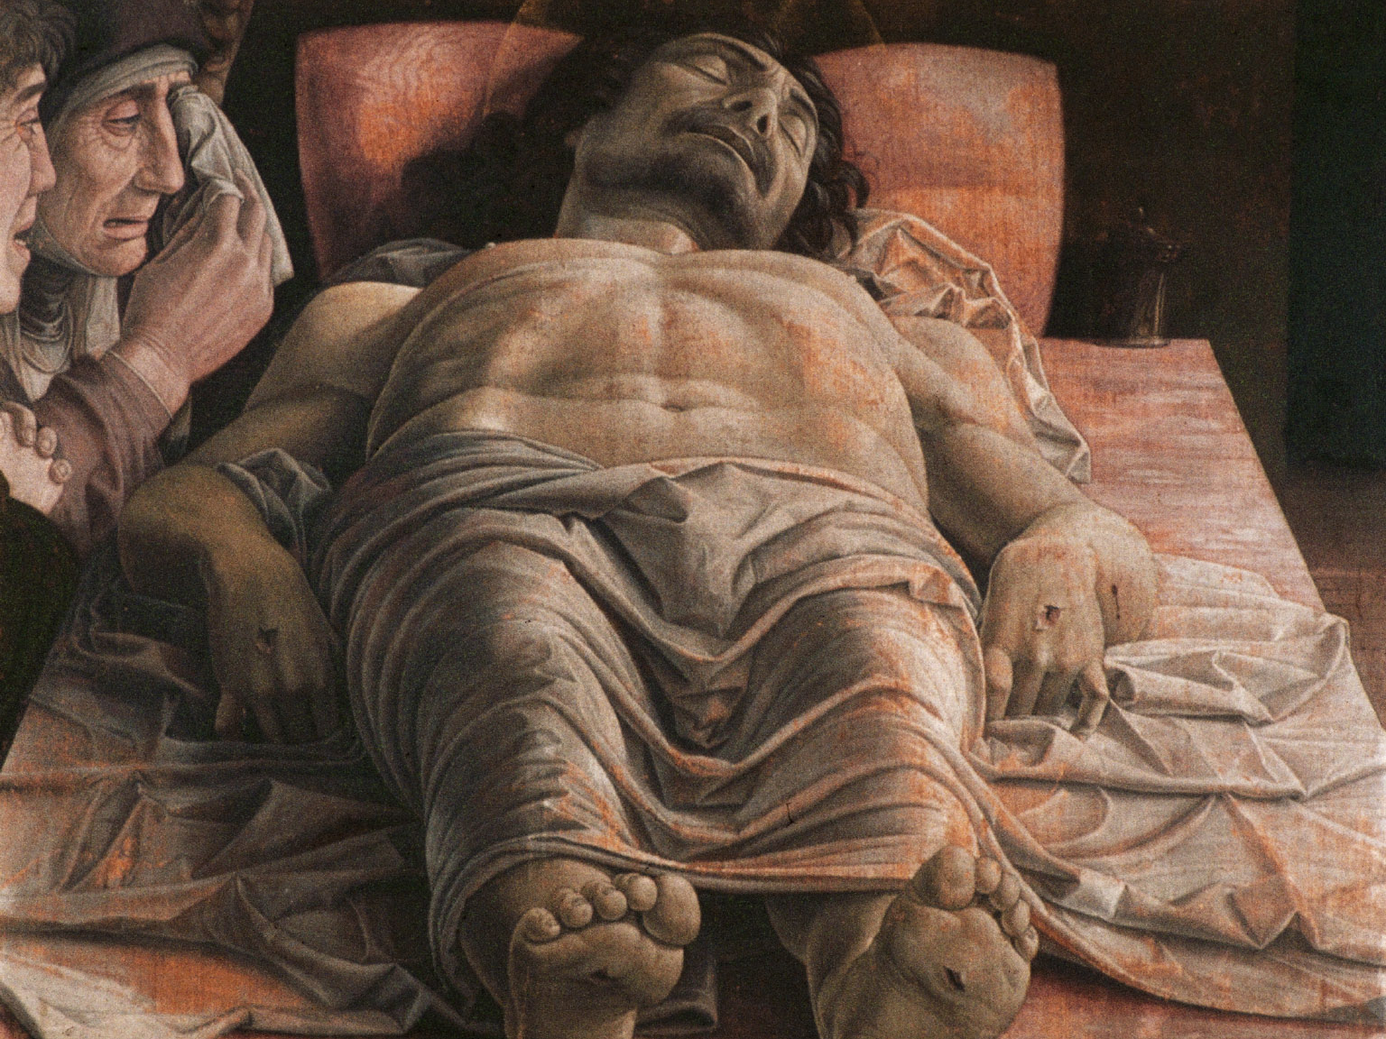
VII

Slide 13
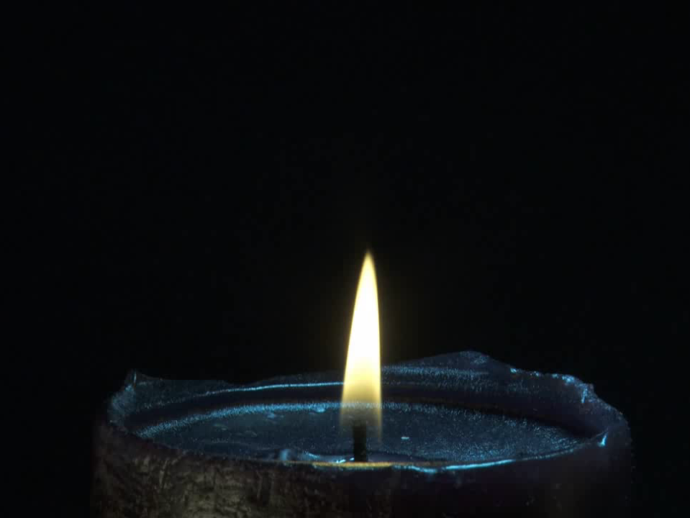

Slide 14
T E N E B R A E

